Slide 1
IFF Updates for TCF
John Seereiter
Chief Engineer

Slide 2
Disclosure
Statement
This information is furnished upon the condition that it will not be released to another nation without specific authority of the Department of the Air Force of the United States, that it will be used for military purposes only, that individual or corporate rights originating in the information, whether patented or not, will be respected, that the recipient will report promptly to the U.S any known or suspected compromise and that the information will be provided substantially the same degree of security afforded it by the Department of Defense.
This presentation is for information only
No U.S. Government commitment to sell, loan, lease, co-develop or co-produce defense articles is implied or intended
Not for Public dissemination

Slide 3
Overview
DoD AIMS Mission
Governing Organizational Chart
DoD AIMS Framework
DoD AIMS Primary Functions
AIMS Organizational Chart
Mode 1 and 2 Phase Out
NATO STANAG 4193 Harmonization
National Secure Mode (NSM)
DoD AIMS UWG

Slide 4
Air Traffic Control Radar Beacon System (ATCRBS)
Identification Friend or Foe (IFF)
Mark XIIB (Mode 1, 2, 3/A, C, 5 and S)
Systems
“AIMS”
An
Acronym of Acronyms
"

Slide 5
DoD AIMS Mission
Independent Evaluation
Performance of the System
Ensure Interoperability
Improve Operational Effectiveness
“Support the Warfighter”
Notes:
Provide an independent evaluation on the systems performance to ensure interoperability and improve operational effectiveness. Our sole purpose it to identify friends and prevent fratricide.

Slide 6
Governing Organization Chart
PBFA
DoD CIO
USAF, USN, USA, NSA, JS, CIO
Allies, NATO
AIMS STEERING COMMITTEE
NSA, FAA, JITC, J-6
DoD International AIMS Program Office
AFLCMC/EZAC
SAF AQ
SAF IA
USAF
USN
USA
USMC
Coast Guard
AIMS USERS
Command Channel
Coordination and
Support Channels

Slide 7

DoD International AIMS
Program Office Framework
Policy/Directive
Foreign Military Sales (FMS)
DoD International AIMS Steering Committee Charter 1977
Frequency Requirements
ACP-190 US SUPP-1(D) Test Event within the US&P
DoD AIMS Program Management Plan (PMP)
2010
DSCA SAMM Chapter 3
DSCA Policy 11-40
(Platform Level)
Interoperability Requirements for Joint Combat Operations (JITC)
NTIA Red Manual for
Stage 3 & 4 Certification
NSA Key Policy Reference #: R 081553Z Dec 2017
Technical Requirements
Documents
DoD AIMS 17-1000
Rev 1.1
2023
DoD AIMS Baseline Certification Requirements Letter OL1826901
DoD AIMS
Test Requirements
Transponders 11XX
Interrogators 12XX
Passive Receiver 13XX
Equipment
Installed Performance
Operational Performance
  ICD for Mk XIIA IFF Mode 5 System Tier 3 Devices 2017
DoD AIMS UAS Secure Link Requirement Letter OL202240
DoD AIMS 17-1000 Classified Addenda
  Joint Key Management Plan (JKMP) 2023
DoD AIMS Supersession Letter OL2026201
  Operational Security Doctrine for Air Identification Friend or Foe (AIFF) 2023
DoD AIMS 04-900(A) 2009
DoD AIMS Sunset and Moratorium on use of Mode 1 and 2 OL2207701
DoD AIMS 1501 Control Panel
Test Requirements
Operational/User
Other Support Documents
DoD AIMS Security Classification Guide (SCG) 2022
DoD AIMS 20-100
Mark XIIB Handbook
2020
Publication (ACP) 160 () IFF/SIF Operational Procedures
Multi-Service Tactics Training Procedures
DoD AIMS 20-100
Supplement 1 2020
Mark XIIA Mode 5 and Mode Select (Mode S) Joint Concept of Operations (Joint CONOPS) Mode 5/ Mode S Joint CONOPS 2021
Notes:
AIMS is responsible for all the purple
Beginning at the top left yellow, Policy/Directives are the polices that govern FMS sales, moving right the purple are the main AIMS directives, the Charter and Program Management Plan, moving down to the red are the Joint Interoperability Test Command for platform interoperability and NSA for Mode 5 Key protection ending up with yellow, Frequency requirements, we support the FAA and Services Spectrum offices as part of the ACP 160 process and a requirement for the NTIA red Manual
The middle row Technical requirements: Purple is the Documents, standards, special requirement letters, test requirements and crypto ICDs and in gold we also support the currency and implementation of Joint Key Management Plan and the Operational Security Doctrine for the Air Identification Friend or Foe
Third row Operational user- purple is the Security Classification Guide, it provides security of the over all system. The Mark XII handbook provides the user an basic understanding of the system ending with blue other support documents and that’s anything related to Mode 5 con-ops we provide technical input to them

Slide 8
Primary Functions
Certification
NO and PIN Assignment
Mode S Address Assignment
DoD International AIMS Program Office
(DoD AIMS PO)
Standards
Foreign Military Sales (FMS) Cases
AIMS CCB NATO IFF CaT ICAO/TSG
CNS-ATM
Support Warfighter
Notes:
Starting in the lower left corner, AIMS CCB develops US positions and agrees to changes to the standards. John Seereiter is the US representative for NATO, he also participates in the international civil aviation organization meetings. Those meetings flow into the next block standards
Standards are where the development of standards and requirements are coordinated with both US civil and NATO requirements which flows into the next block our certification process where we certify platforms according to the established standards derived from the previous two blocks
We provide all the default codes for US National Origin PIN and operational Mode S for the US military.
For FMS support we are funded either by a direct FMS case or on an existing case by line item
And this is how we support the warfighter to make sure the system works

Slide 9
Government Personnel
John Seereiter
NH-04
Chief Engineer
Jerome Jones
NH-04
IFF Technical Expert
Victor Lightfoot
NH-03
Electronics Engineer
Tom Cannon
GS-13
Program Manager

Slide 10
Contract Support Personnel
Vacant
On-Site Senior PM III
April Griner
Senior Advisor
Michael Walsh Lead Test Engineer III
Dominic Anello
Sr. Test Engineer
Doug Voigt
Test Engineer II
Ashton Griffith
Engineer I
Bob Bell
Security Specialist
Andre Lewis
Sr. Test Engineer
Dakota Lawson
Test Engineer II
Ben Johnson
Engineer I
Keila Roper
Project Manager
Ken Kelsey
Sr. Test Engineer
Ronald Mais
Engineer II
Vacant
Engineer I
Shaniqua Jones
Sr. Finance Analyst
Vacant
Test Engineer II
Richard Lowery
Mode S Administrator
Nathan Haney
Japanese Liaison
Crystal Sims
FMS/Finance Analyst
Alan “AJ” Sowers
Test Engineer II
Levi Stanfill
Test Engineer I
Vacant
Test Engineer I
Miriam Hallidy
Office Manager/Program Assistant

Slide 11
Mode 1 and 2 (RF) Phase Out
The OPSEC rationale for SIF M1/M2 (RF) phase out is clear:
    SIF M1/M2 provided unencrypted via Free Space - EXPLOITABLE
    Same codes are available encrypted via Mode 5 – SECURE
The RF performance improvement is substantial, especially for airborne interrogators
This operation is meant for a Mode 5 only AOR as there is still a need to use SIF M1/M2 for non-military operations and training
There is no modification to equipment as this can be used today by disabling the transponder’s SIF M1/M2 and interrogators not interrogating SIF M1/M2 (RF)
M1/M2 (RF) phase out results in:
Improved Mode 5 performance
Improved SIF Mode 3/A and Mode C performance
Reduced 1030/1090 MHz Mutual Interference
Reduction in SIF and Mode 5 false targets
  SIF M1/M2 (RF) Phase Out greatly improves overall Secondary Search Radar/IFF performance

Slide 12
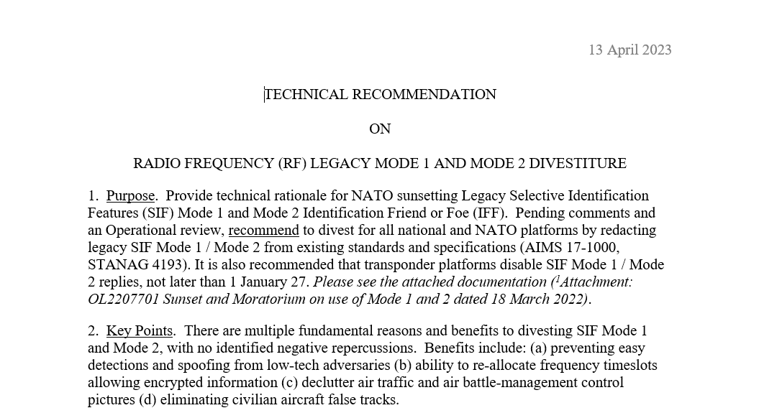
SIF Mode 1 and 2 (RF) Phase Out
On April 13, 2023, NATO IFF CaT created a working paper: “Technical Recommendation on Radio Frequency (RF) Legacy Mode 1 and 2 Divestiture”

Slide 13
NATO STANAG 4193 Vs DoD AIMS
STANAG 4193
DoD AIMS
Edition 1
03-1000
Edition 2
03-1000A
Edition 2+
M5L1
03-1000A Rev 1
Edition 2++
M5L1 & 2
03-1000A Rev 1 and adds OL 1519702
Edition 3
Current Equipment
03-1000B Amendment 1
17-1000 Rev 1.1 (Mark XIIB) Removes Mode 4, includes Mode S Military Interrogator, Passive reception, ADS-B and Mode 5 Level 2-B,
No STANAG Equivalent
Note: DoD AIMS only certifies to 17-1000 Rev 1

Slide 14
NATO STANAG 4193 Vs DoD AIMS
NATO STANAG 4193 Edition 4:
    Work has started with approved change notes
    The IFF CaT agreed to reformat the STANAG 4193 Edition 4 resemble DoD AIMS 17-1000 Rev 1.1 structure
    First Harmonization meeting to compare the difference between the two documents
    The Goal is to make these two documents “look” the same with minor differences

Slide 15
National Secure Mode (NSM)
NATO Position:
    This policy applies to the transfer and use of Mode 5 technical details for NSM development by all NATO Nations and Partners. The restrictions will be implemented upon ratification of this policy.
    The IFF Mode 5 waveform is only to be used with NSA/SECAN approved encryption devices.
    The future use or incorporation of IFF Mode 5 NATO technology to design a NSM is prohibited by any NATO nation or its Industries.
    Any previously developed waveforms or technical designs that share any characteristics with Mode 5 are prohibited and should be destroyed and no longer promulgated, used, or supported by NATO Nations and their Industries.

Slide 16
National Secure Mode (NSM)
Future Actions:
    NATO must finalize the NSM policy
    DoD CIO is looking to create a US Policy on NSM

Slide 17
2024 DoD AIMS User Working Group (UWG)
AIMS User Working Group (UWG) is an annual event hosted by the AIMS Program Office
Purpose: To bring the IFF community together for teaching seminars and vendor demonstrations. It also provides an opportunity for the user to interface directly with the AIMS PO to discuss issues of importance or concern.

Slide 18
2024 DoD AIMS User Working Group (UWG)
The goal is to ensure IFF interoperability and promote the identification of friends and prevention of fratricide.
2024 UWG dates 25-29 March 2024 in Atlanta, GA (in contracting)
APAN address: https://community.apan.org/wg/aimsug/

Slide 19
Points of
Contact
John Seereiter – Chief Engineer, Office: +1-478-926-9589
Email: john.seereiter@us.af.mil
Jerome Jones – IFF Subject Matter Expert, Office: +1-478-327-4439
Email: jerome.jones.5@us.af.mil
Tom Cannon – Program Manager, Cell: +1-478-551-0215
Email: thomas.cannon.5@us.af.mil

